Slide 1
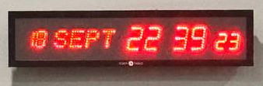

Slide 4
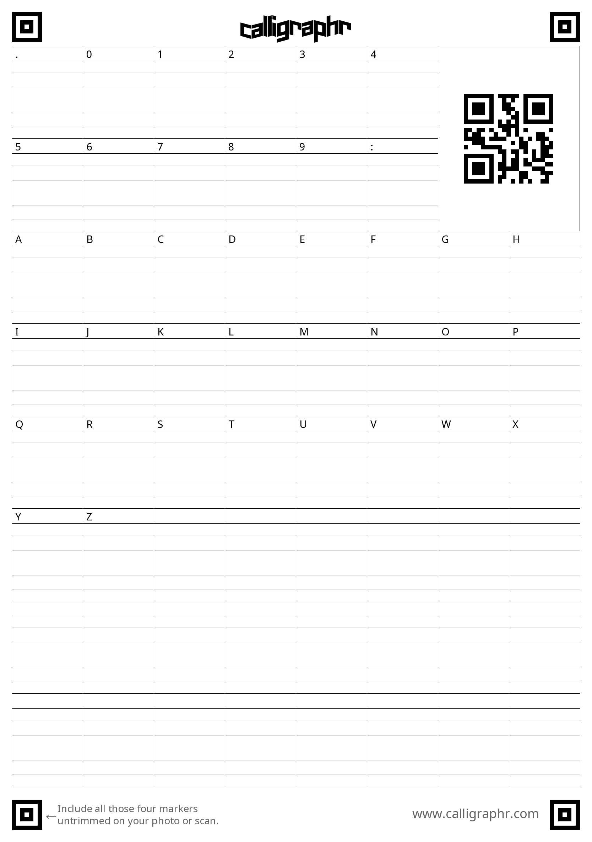
Notes:
Select all using Ctrl+A, right-click, then “Save as Picture...” and save the image. Upload to calligraphr to create the font: https://www.calligraphr.com/

